Slide 1
Date
May 25, 2021
The Era of Digital Transformation: Building A Privacy and Security Practice in the Ever-Changing Landscape
Ihor Malchenyuk - Moderator
CISO & DPO at 1touch.io
Zak Rubinstein
CEO & Founder at 1touch.io
Behnam Dayanim
Chair, Data Privacy & Cybersecurity Practice at Paul Hastings LLP

Slide 2
Main Challenges
Understanding what you have, where it is and why you have it
Valuing and prioritizing data
Appropriate use of automation/programmatic tools
Vendor management/third-party supply chain
What rules apply

Slide 3
Privacy – Best Practices
Multiple and not entirely consistent laws and regulations
CCPA/CPRA, GDPR, VDCPA, etc.
Data classification, inventory, mapping
Understanding and implementing DSARs
COVID effects – what is collected and why
AI – EU principles and implications

Slide 4
Inventa™
Executing Data Aware Security
MAY 2021

Slide 5
How Does it Work?
Produce Data Mapping
Produce Master Catalog, Data Mapping and Data Flow
Monitor Network Traffic
Passively monitor network and identify network elements
Consolidate Personal DAta
Consolidate Personal Data 'Compare all data to the Root Data Asset (customer list)
Identify sensitive data on the network
Identify sensitive data in motion and profile the entire network to identify 'suspected’ repositories holding personal data
Scan Repositories
Scan structured and unstructured repositories

Slide 6
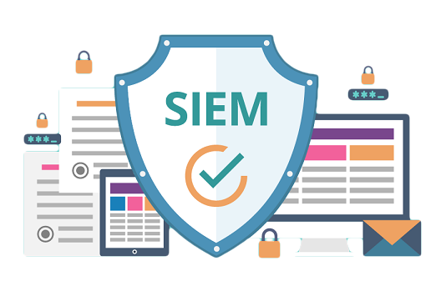
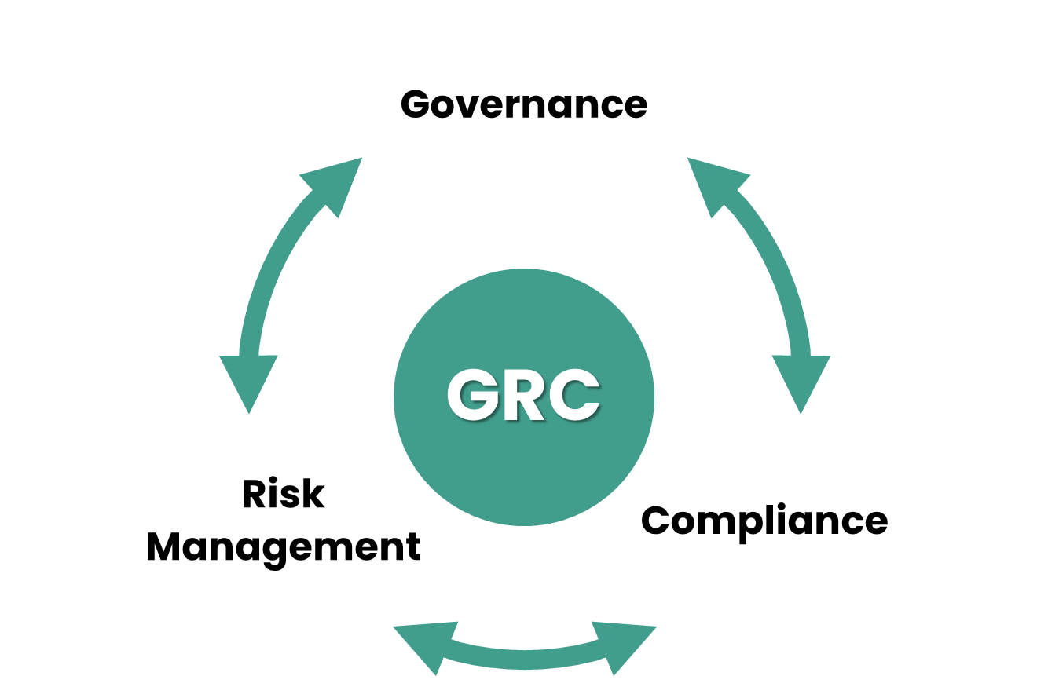
Quality
Risk
Audit
Regulation
Employee Data
Customer Data
Lead Data
Security
Virtual Data Lake

Slide 7
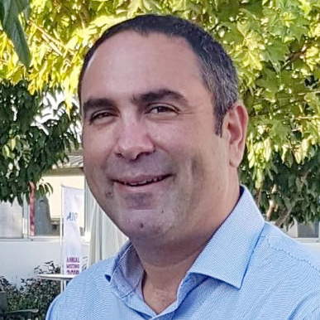
Questions + Contact
Behnam Dayanim
Chair, Data Privacy & Cybersecurity Practice
Paul Hastings LLP
202.551.1737
Bdayanim@paulhastings.com
@bdayanim @PHprivacy
Email
Zak Rubinstein
CEO & Founder
1touch.io
zak@1touch.io
Ihor Malchenyuk
CISO & DPO
1touch.io
ihor.malchenyuk@1touch.io

